Slide 1
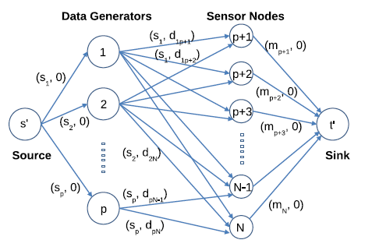
Project On Maximizing Data Resilience in Wireless
Sensor Networks in Extreme Environments
Keyword: Data Resilience, Wireless, Sensor Networks
Presented by: Jieli Chen
Professor: Dr. Tang
5/10/2017
Presented by Jieli Chen
Notes:
Software Defined Networks; Routing; Flow Scheduling

Slide 2
Content
Basic Introduction
Project 1 Description
Project 1 Result Display
Project 2 Description
Project 2 Result Analysis
Conclusion
Concerns and Future work
Presented by Jieli Chen
Notes:
Software Defined Networks; Routing; Flow Scheduling

Slide 3
Content
Basic Introduction
Project 1 Description
Project 1 Result Display
Project 2 Description
Project 2 Result Analysis
Conclusion
Concerns and Future Work
Presented by Jieli Chen
Notes:
Software Defined Networks; Routing; Flow Scheduling

Slide 4
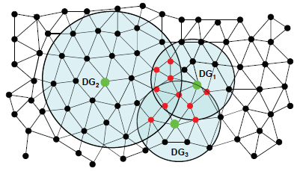
Basic Introduction
Wireless Sensor Networks
- Wireless
- Sensor Nodes Randomly in Plot
Initial Energy
x, y position in an area
- Represented as Graph ( V, E)
- Same Tr among Nodes
- Data Generators DGs
- DGs offload data to Non DGs
Number of Data Items q
- Non DGs attributes
Storage Capacity( mi )
pq <= (N-p)m
P – # of DGs
q - # of data item to offload for each DGs
N - # of sensor nodes
M – storage capacity of each Non DGs
Et(k, l) = Eelec * k + Eamp * k * l * l,
Er(k) = Eelec * k
wu,v = Et(k, l) + Er(k)
Presented by Jieli Chen
Notes:
Software Defined Networks; Routing; Flow Scheduling

Slide 5
Content
Basic Introduction
Project 1 Description
Project 1 Result Display
Project 2 Description
Project 2 Result Analysis
Conclusion
Concerns and Future Work
Presented by Jieli Chen
Notes:
Software Defined Networks; Routing; Flow Scheduling

Slide 6
Project 1 Description
Objectives
- Generate Sensor Network ( Undirected Graph)
DGs and their attributes
Non DGs and their attibutes
Connections between nodes (edges)
- Check connection of sensor network
Adjacency List of Each Nodes
BFS tranversal to check connection
Get shortest Path by Dijkstra Shortest Path algorithm between any two nodes if connected
- Calculate Energy Consumption to send a data from node U to node V
Shortest distance
wu,v = Et(k, l) + Er(k)
- Draw a plot to show relationship between Nmin and Tr
Mathematically represent relationship by equation
BFS tranveral for each Pair of (N, Tr)
Presented by Jieli Chen
Notes:
Software Defined Networks; Routing; Flow Scheduling

Slide 7
Content
Basic Introduction
Project 1 Description
Project 1 Result Display
Project 2 Description
Project 2 Result Analysis
Conclusion
Concerns and Future Work
Presented by Jieli Chen
Notes:
Software Defined Networks; Routing; Flow Scheduling

Slide 8
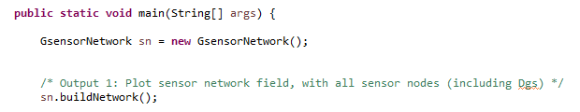

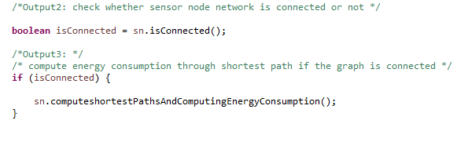
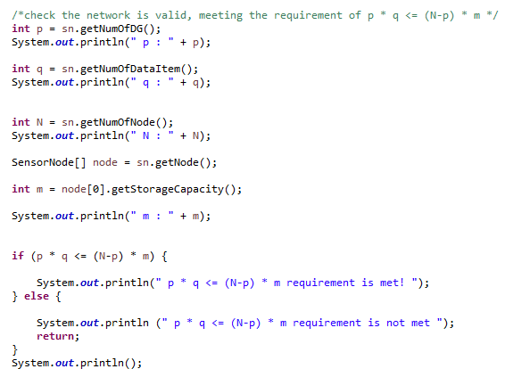
Project 1 Result Display
Step 1: build Network
Step 3:create adjacency list for all the sensor nodes
Step 2: check the network is valid, meeting the requirement of p * q <= (N-p) * m
Step 4: check whether sensor node network is connected
Presented by Jieli Chen
Notes:
Define an interface or abstract class for creating an object, but let the subclasses decide which class to instantiate.
That is, subclasses are responsible to create the instance of the class.
Both the Abstract Factory Pattern and the Factory Method Pattern decouples the client system from the actual implementation classes through the abstract types and factories.
Software Defined Networks; Routing; Flow Scheduling

Slide 9
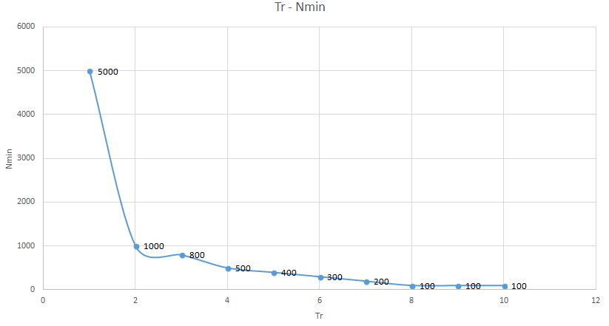
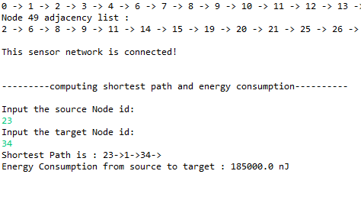
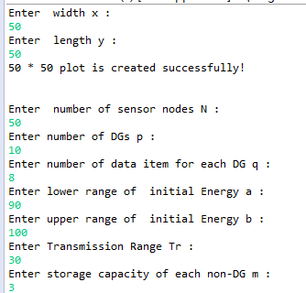
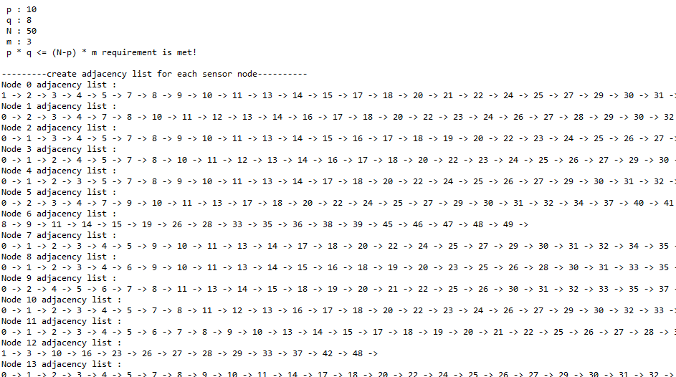
Project 1 Result Display(Cont.)
Step 5: Draw a plot to show the relationship between N min and Tr
Step 6: Give The math equation of N min and Tr
N min = x*y/(Tr * Tr *3.14) + 1 ;
X – the width of network plot
Y – the length of network plot
Step 7: output result
Presented by Jieli Chen
Notes:
Define an interface or abstract class for creating an object, but let the subclasses decide which class to instantiate.
That is, subclasses are responsible to create the instance of the class.
Both the Abstract Factory Pattern and the Factory Method Pattern decouples the client system from the actual implementation classes through the abstract types and factories.
Software Defined Networks; Routing; Flow Scheduling

Slide 10
Content
Basic Introduction
Project 1 Description
Project 1 Result Display
Project 2 Description
Project 2 Result Analysis
Conclusion
Concerns and Future Work
Presented by Jieli Chen
Notes:
Software Defined Networks; Routing; Flow Scheduling

Slide 11
Project 2 Description(Cont.)
Problem Description
- Connected sensor network as project 1, only one DG to send data to other Non DGs
- Data Resilience Against Storage Overflow Disruption In Extreme Environments.
Objectives
- Network-Based Algorithm implementation & Analysis
- Node-Based Algorithm implementation & Analysis
- Data-Based Algorithm implementation & Analysis
- Benefit-Based Algorithm implementation & Analysis
Presented by Jieli Chen
Notes:
Data resilience refers to the ability of any network to recover quickly and to continue
maintaining availability of data despite of disruptions such
as equipment failure, power outage, or malicious attack.
Given a sensor network
with a data items to be preserved, data resilience level
is defined as the sum of remaining energy of the destination
nodes of all the a data items
Pa
j=1 E0
r(j).
Software Defined Networks; Routing; Flow Scheduling

Slide 12
Content
Basic Introduction
Project 1 Description
Project 1 Result Display
Project 2 Description
Project 2 Result Analysis
Conclusion
Concerns and Future Work
Presented by Jieli Chen
Notes:
Software Defined Networks; Routing; Flow Scheduling

Slide 13




Project 2 Result Analysis
Network-Based Algorithm implementation & Analysis
- sort all Non DGs in non-ascending order of their initial energy
- Find the top k + 1 highest energy nodes
-
Get Data resilience level
- Time Complexity : O(k * n) without considering sorting
Presented by Jieli Chen
Notes:
Data resilience refers to the ability of any network to recover quickly and to continue
maintaining availability of data despite of disruptions such
as equipment failure, power outage, or malicious attack.
remote and inaccessible regions such as underwater or
underground, or inhospitable regions under extreme weather
Software Defined Networks; Routing; Flow Scheduling

Slide 14
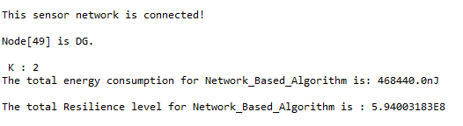
Project 2 Result Analysis(cont.)
Network-Based Algorithm result Display
Presented by Jieli Chen
Notes:
Data resilience refers to the ability of any network to recover quickly and to continue
maintaining availability of data despite of disruptions such
as equipment failure, power outage, or malicious attack.
remote and inaccessible regions such as underwater or
underground, or inhospitable regions under extreme weather
Software Defined Networks; Routing; Flow Scheduling

Slide 15
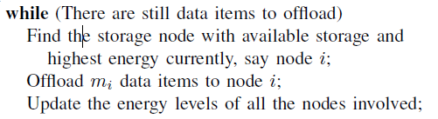
Project 2 Result Analysis(cont.)
Node-Based Algorithm implementation & Analysis
- sort all Non DGs in non-ascending order of their initial energy
- Find the top highest energy nodes
- Get Data resilience level
- Time complexity : O(k*n) without considering sorting
Presented by Jieli Chen
Notes:
Data resilience refers to the ability of any network to recover quickly and to continue
maintaining availability of data despite of disruptions such
as equipment failure, power outage, or malicious attack.
remote and inaccessible regions such as underwater or
underground, or inhospitable regions under extreme weather
Software Defined Networks; Routing; Flow Scheduling

Slide 16

Project 2 Result Analysis(cont.)
Node-Based Algorithm Result Display
Presented by Jieli Chen
Notes:
Data resilience refers to the ability of any network to recover quickly and to continue
maintaining availability of data despite of disruptions such
as equipment failure, power outage, or malicious attack.
remote and inaccessible regions such as underwater or
underground, or inhospitable regions under extreme weather
Software Defined Networks; Routing; Flow Scheduling

Slide 17
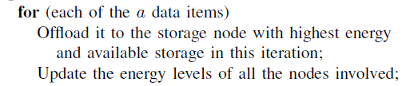
Project 2 Result Analysis(cont.)
Data-Based Algorithm implementation & Analysis
- sort all Non DGs in non-ascending order of their initial energy
- executes in a iterations: offload each data item to the highest energy storage Node
- Get Data resilience level
- Time Complexity : for each a, to updat the energy levels of at most n nodes, takes O(n), so totally O(a * n )
Presented by Jieli Chen
Notes:
Data resilience refers to the ability of any network to recover quickly and to continue
maintaining availability of data despite of disruptions such
as equipment failure, power outage, or malicious attack.
remote and inaccessible regions such as underwater or
underground, or inhospitable regions under extreme weather
Software Defined Networks; Routing; Flow Scheduling

Slide 18

Project 2 Result Analysis(cont.)
Data-Based Algorithm Result Display
Presented by Jieli Chen
Notes:
Data resilience refers to the ability of any network to recover quickly and to continue
maintaining availability of data despite of disruptions such
as equipment failure, power outage, or malicious attack.
remote and inaccessible regions such as underwater or
underground, or inhospitable regions under extreme weather
Software Defined Networks; Routing; Flow Scheduling

Slide 19
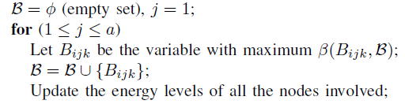
Project 2 Result Analysis(cont.)
Benefit-Based Algorithm implementation & Analysis
- Benefit of Offloading a Datum: denote the set of variables that have already been selected.
- Set Bijk: the increase of the data resilience level when Bijk is selected
given B.
- Get Data resilience level
- Time Complexity : O (n2) for each a, totally O(a * n2)
Presented by Jieli Chen
Notes:
Data resilience refers to the ability of any network to recover quickly and to continue
maintaining availability of data despite of disruptions such
as equipment failure, power outage, or malicious attack.
remote and inaccessible regions such as underwater or
underground, or inhospitable regions under extreme weather
Software Defined Networks; Routing; Flow Scheduling

Slide 20

Project 2 Result Analysis(cont.)
Benefit-Based Algorithm Result Display
Presented by Jieli Chen
Notes:
Data resilience refers to the ability of any network to recover quickly and to continue
maintaining availability of data despite of disruptions such
as equipment failure, power outage, or malicious attack.
remote and inaccessible regions such as underwater or
underground, or inhospitable regions under extreme weather
Software Defined Networks; Routing; Flow Scheduling

Slide 21
Content
Basic Introduction
Project 1 Description
Project 1 Result Display
Project 2 Description
Project 2 Result Analysis
Conclusion
Concerns and Future Work
Presented by Jieli Chen
Notes:
Software Defined Networks; Routing; Flow Scheduling

Slide 22
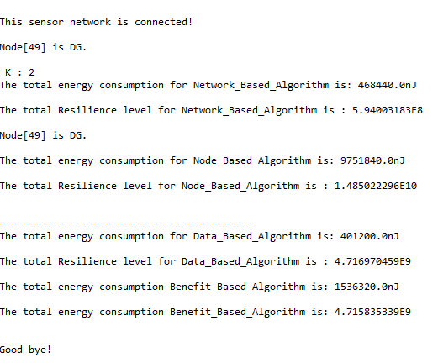
Conclusion
Benefit-Based Algorithm
- high data resilience level
- More energy consumption
- high time complexity
Network-Based Algorithm
- low data resilience level
- low energy consumption
- low time complexity
Presented by Jieli Chen
Notes:
Data resilience refers to the ability of any network to recover quickly and to continue
maintaining availability of data despite of disruptions such
as equipment failure, power outage, or malicious attack.
remote and inaccessible regions such as underwater or
underground, or inhospitable regions under extreme weather
Software Defined Networks; Routing; Flow Scheduling

Slide 23
Content
Basic Introduction
Project 1 Description
Project 1 Result Display
Project 2 Description
Project 2 Result Analysis
Conclusion
Concerns and Future Work
Presented by Jieli Chen
Notes:
Software Defined Networks; Routing; Flow Scheduling

Slide 24
Conclusion
More data to support conclusion
Not considering sorting when calculation time complexity
Presented by Jieli Chen
Notes:
Data resilience refers to the ability of any network to recover quickly and to continue
maintaining availability of data despite of disruptions such
as equipment failure, power outage, or malicious attack.
remote and inaccessible regions such as underwater or
underground, or inhospitable regions under extreme weather
Software Defined Networks; Routing; Flow Scheduling

Slide 25
Question??
Presented by Jieli Chen
Notes:
Software Defined Networks; Routing; Flow Scheduling

